Slide 1
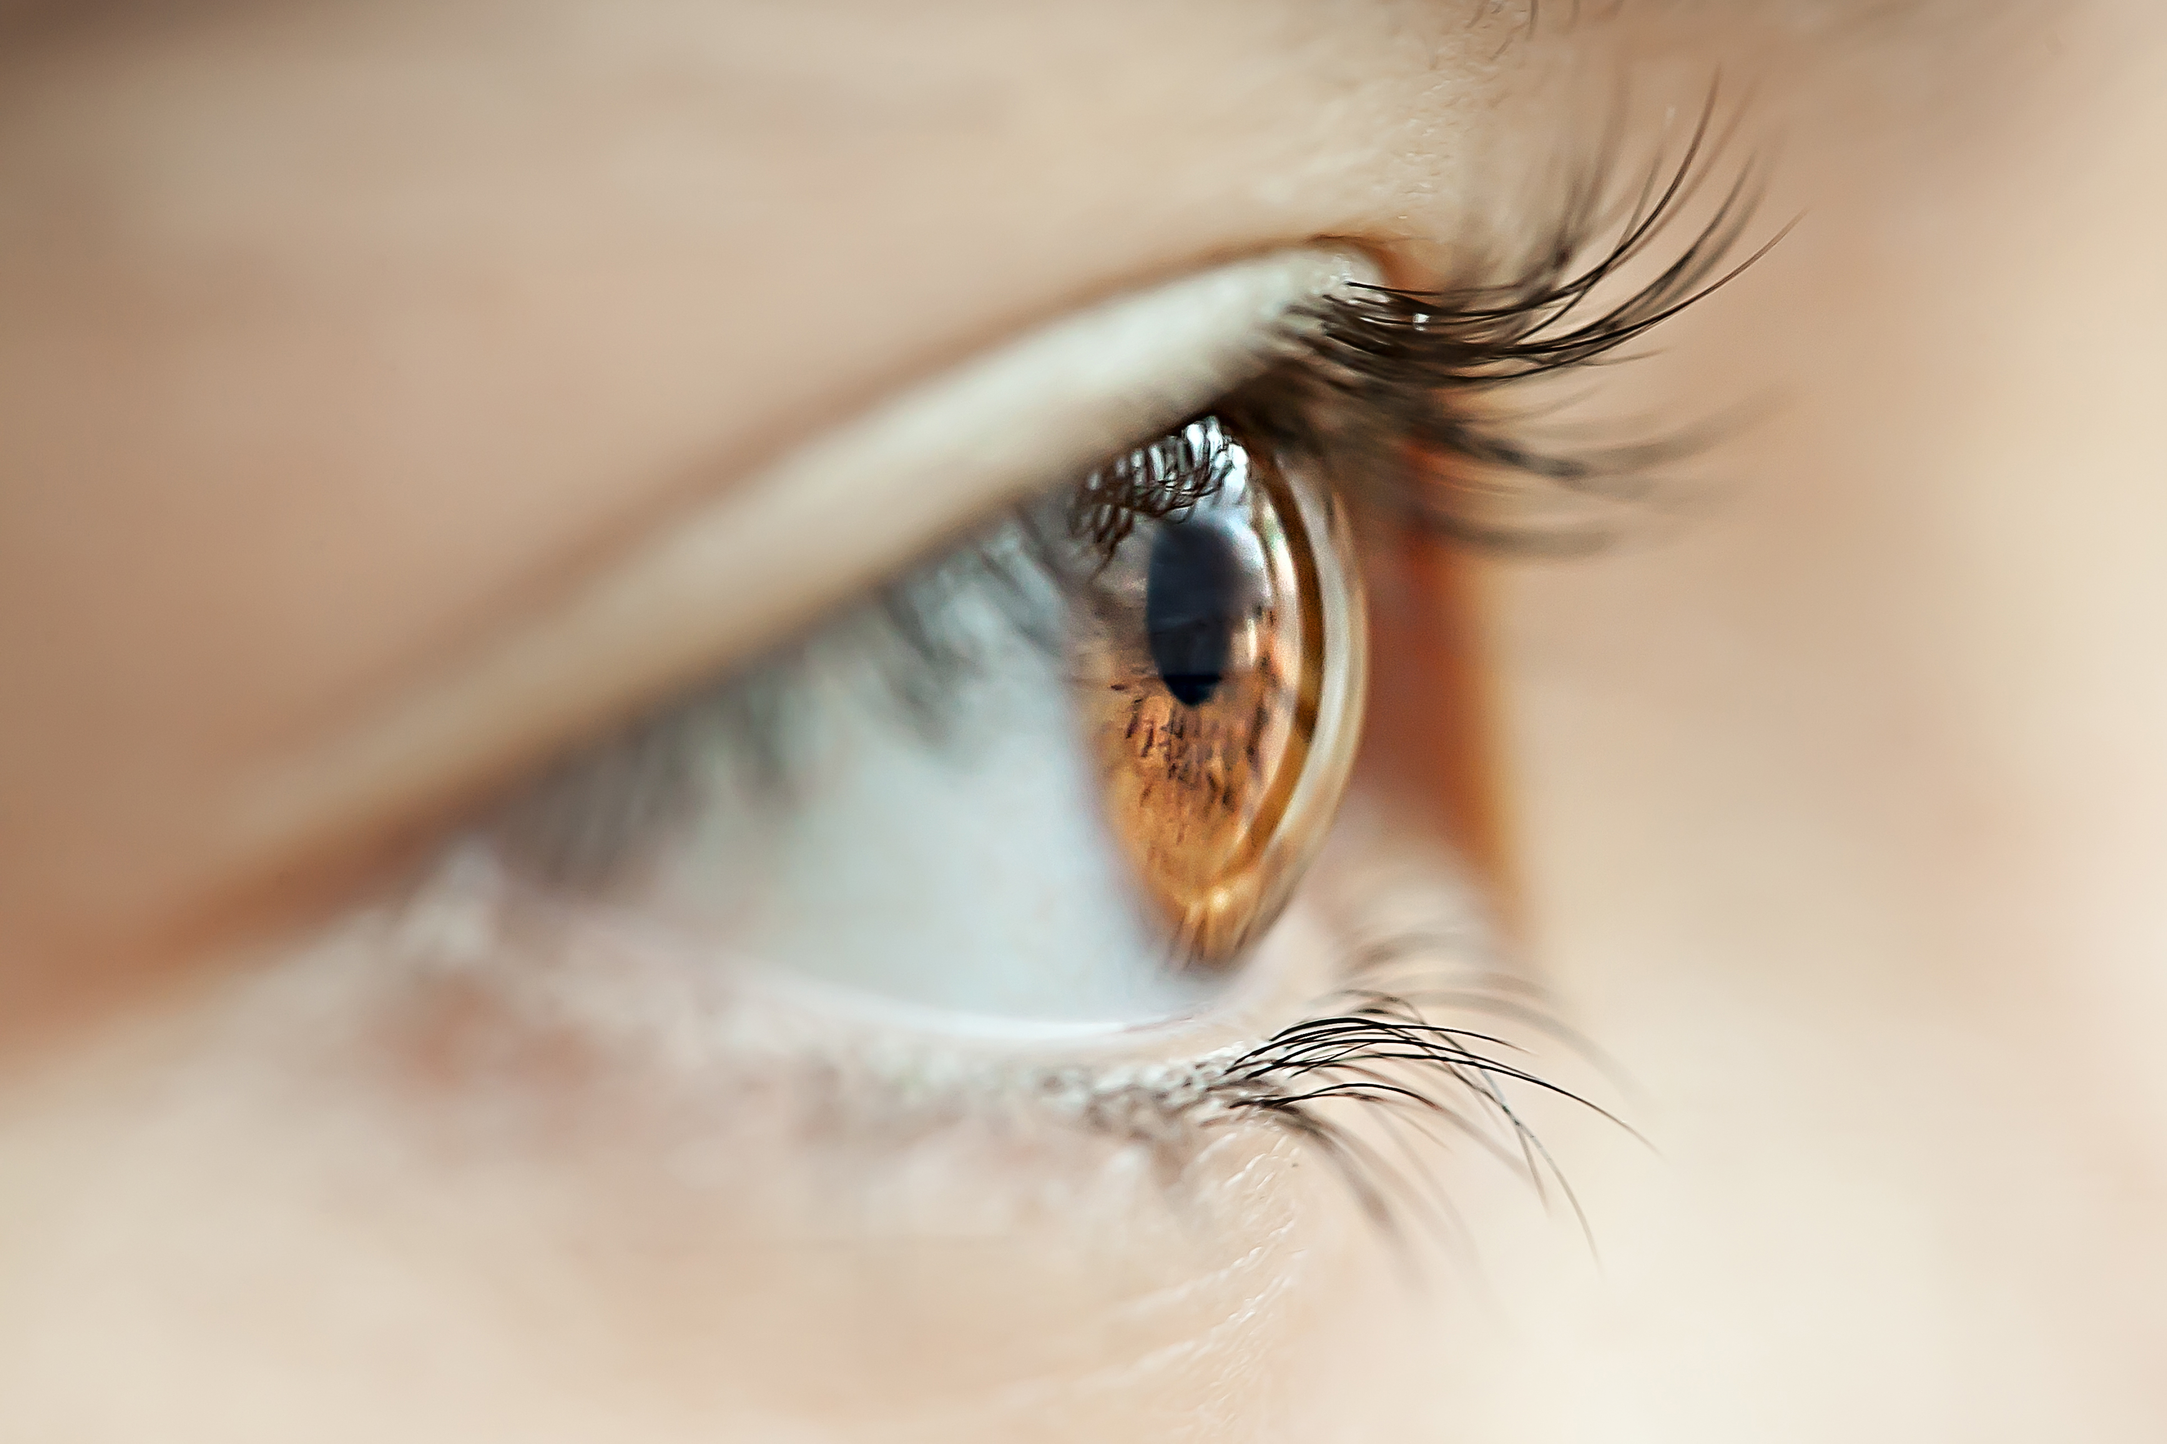
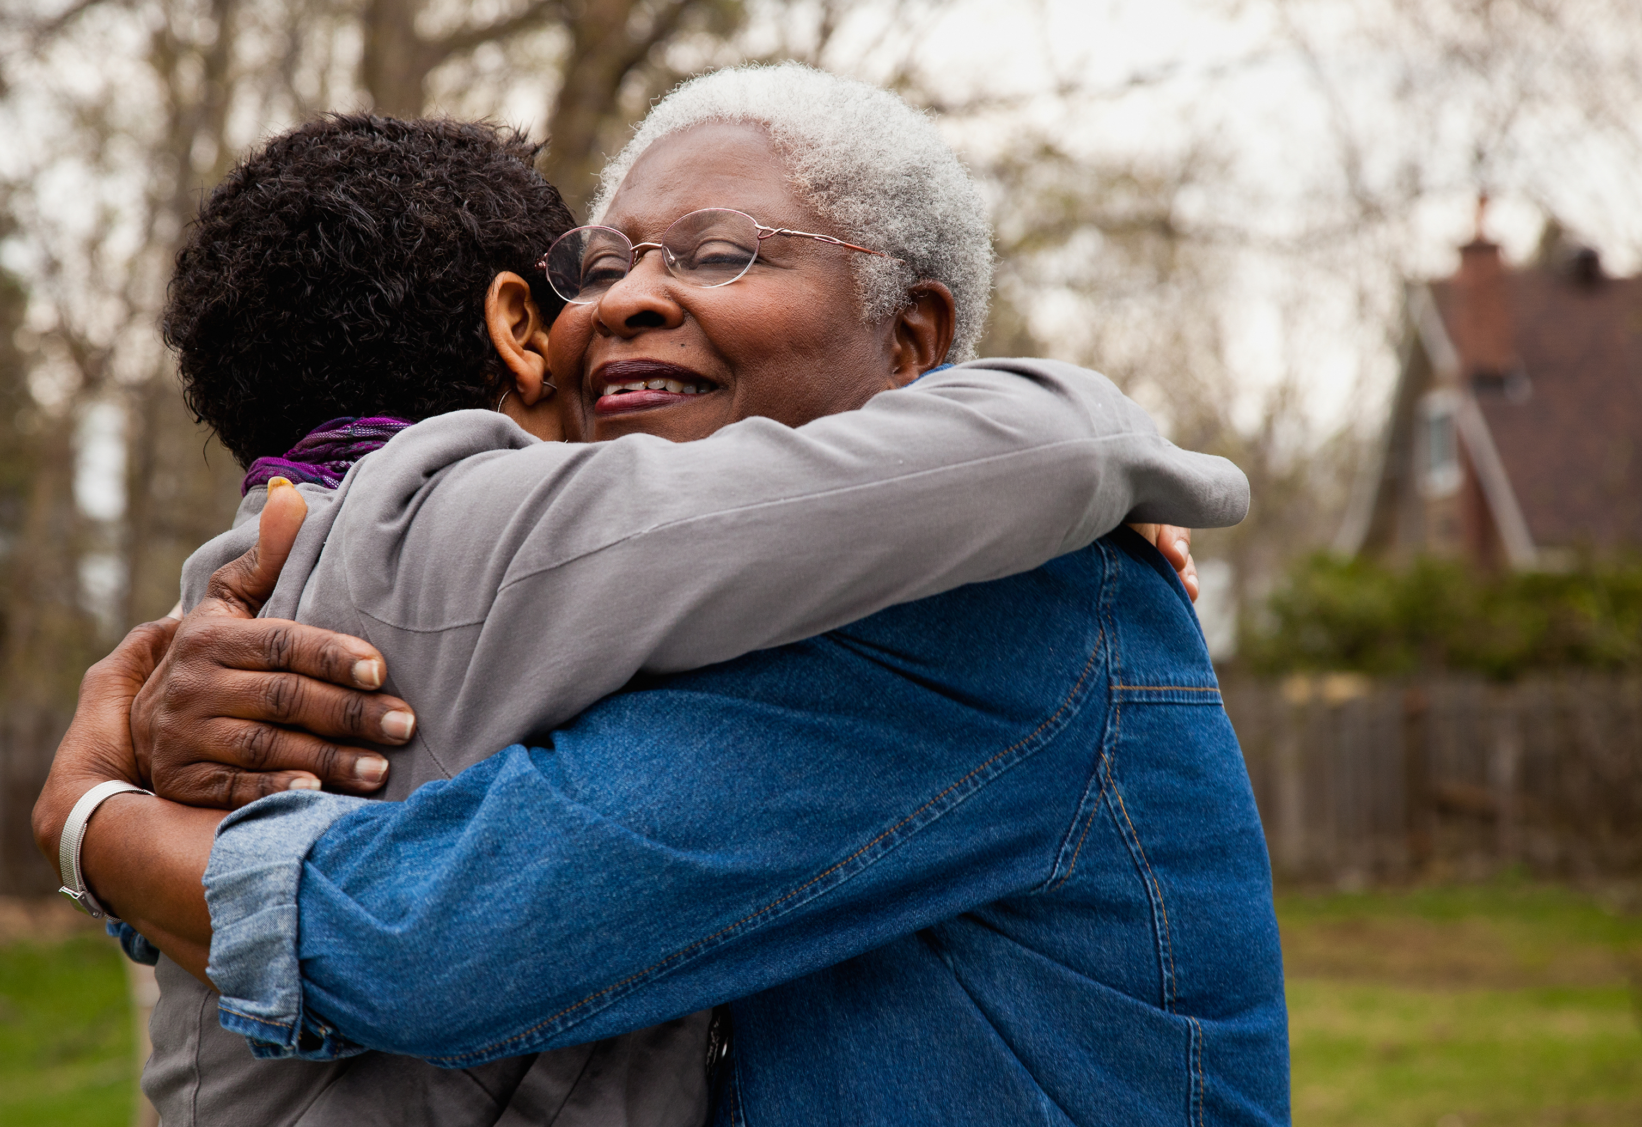
Leading with Empathy

Slide 2
What is Empathy?
How is it different from sympathy?

Slide 3
Sympathy and Empathy Dr. Brené Brown Research Professor at University of Houston in areas of shame, vulnerability, courage and empathy

Slide 4
Thoughts and takeaways
What did you learn about yourself?
What came up for you as you watched?

Slide 5
The Sweater

Slide 6
In 2018: 18% of workers were living with anxiety disorder In 2020: 30% of people had an anxiety disorder; 42% of people in their 20s 50% of millennials and 75% of Gen Z say they’ve quit a job for mental health reasons
Adrian Gostick & Chester Elton

Slide 7
What might be indications?

Slide 8
Leading with Empathy

Slide 9
Seen
Heard
Understood
We who are strong ought to bear the weaknesses of those without
strength,
and not just please ourselves.
Romans 15:1

Slide 10
Notice Listen Be empathetic

Slide 11
•Recognize their perspective •Refrain from judging •Recognize their emotion •Communicate that recognition

Slide 12
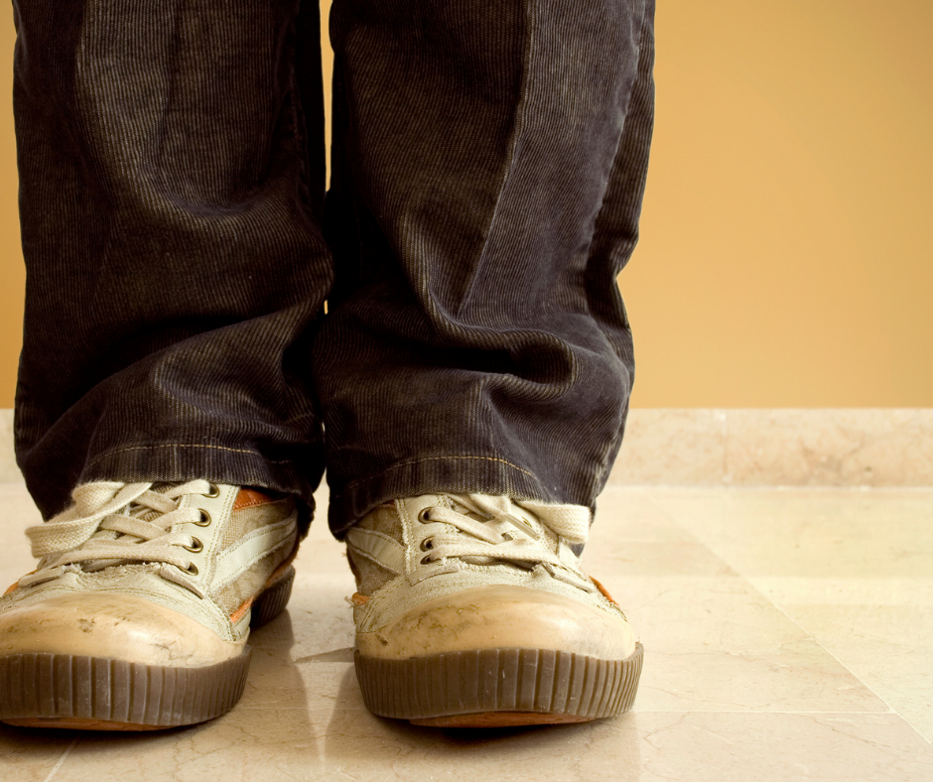
It’s common to hear: Don’t just stand there, do something. Empathy compels us: Don’t just do something, stand there.
David Tubley

Slide 13
“Rarely can a response make something better, what makes something better is connection.”
Brené Brown

Slide 14
Key Takeaways
What will you commit to doing differently?

