Slide 1
TRANSFORMATIONAL LEADERSHIP:
Your HEART Matters!

Slide 2
Objectives for Your Heart Matters Workshop:
To interpret the biblical definition of the heart
To learn what the Bible states concerning our hearts
To discuss why the condition of our hearts matter and
why it matters as we lead others
To decide the next steps as it pertains to our hearts and
leadership

Slide 3
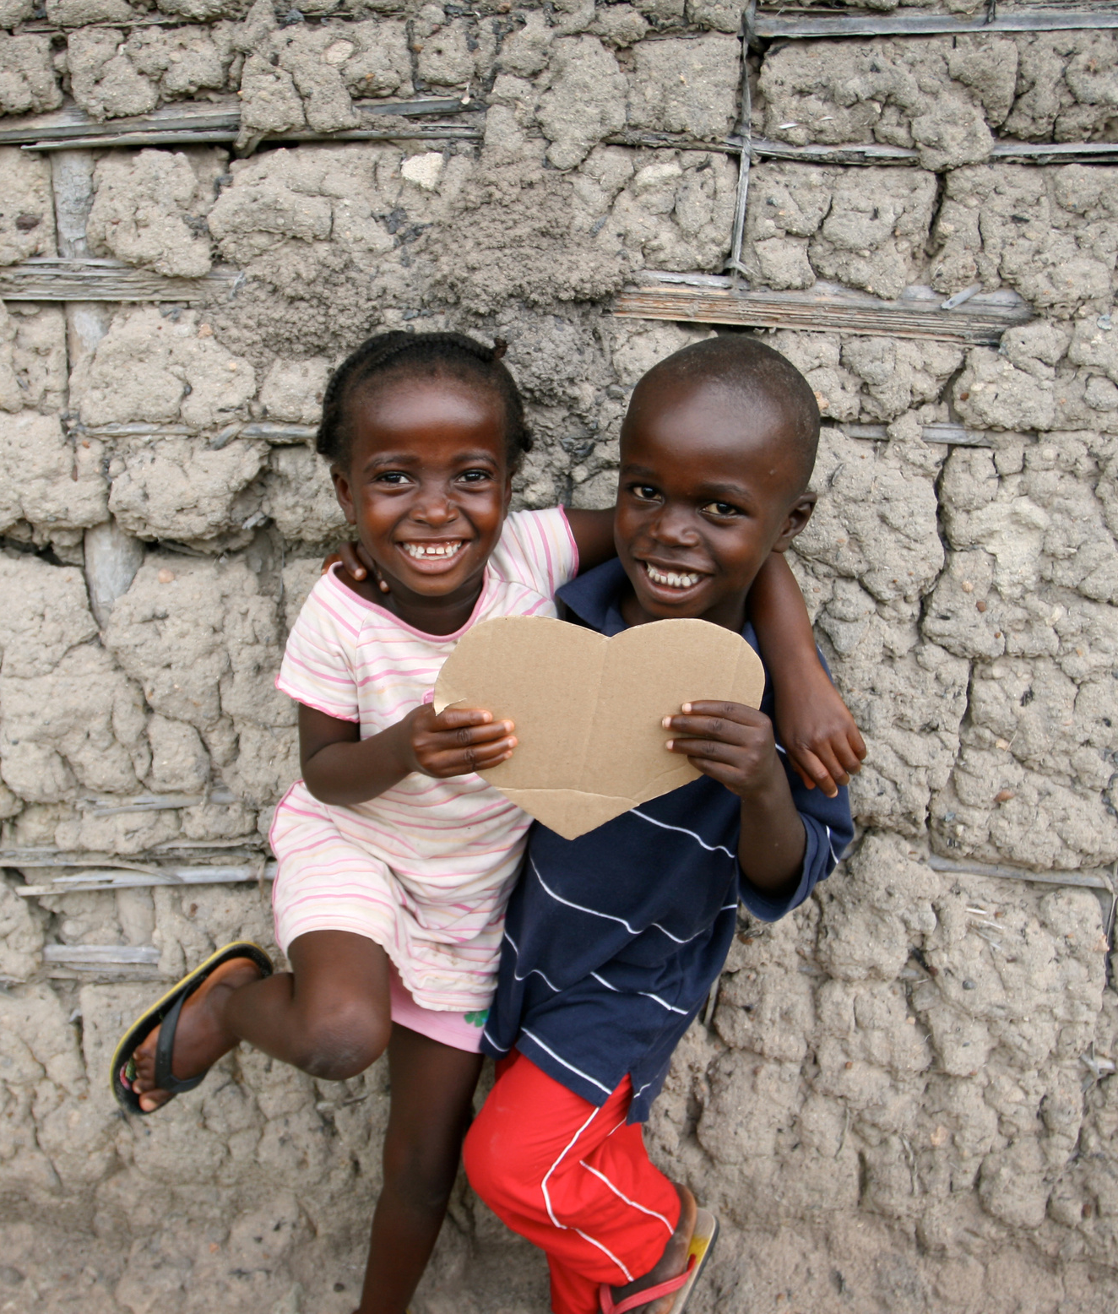
Every 34 seconds
One person in the United States dies from heart disease.
According to the CDC
Notes:
How many people will die physically while we’re on this workshop this morning? This demonstrates the prevalence of heart disease from a physical aspect. The heart (the physical organ) is the lifeline of the body. Life flows from the heart. It is the center of our physical being. The Bible speaks of the heart in a metaphorical sense.

Slide 4
But what is
the heart as revealed in Scripture?

Slide 5
Get your phones out!
Notes:
Slido.com
#7146154

Slide 6
Hebrew: leb
Phonetic Spelling: (labe)
Greek : kardia
Phonetic Spelling: (kar-dee'-ah)

Slide 7
According to the Bible:
The heart is the core of our being;
the mind, character, inner self, will, intention, center;
the seat of the thoughts, passions, desires,
appetites, affections, purposes, endeavors;
the seat of our emotions;
the essence of who we are;
it's the real you!

Slide 8
Guard your heart above all else, for it determines the course of your life.
Proverbs 4:23

Slide 9
Guard Your Heart
Notes:
Tony Evans’s Devotional video: A Spiritual Attack on Your Heart

Slide 10
Mark 7:14-23
Notes:
Early in this chapel, Jesus is having a conversation with the Pharisees and some of the scribes concerning tradition. And one of the traditions involved is the washing of the hands before breaking bread. The Jews held a ceremonial tradition of detailed and ritualistic handwashing before breaking bread. When they come from the marketplace, they do not eat unless they completely cleanse themselves.
asked Him, “Why do Your disciples not walk in accordance with the tradition of the elders, but eat their bread with unholy hands?” ⁶ But He said to them, “Rightly did Isaiah prophesy about you hypocrites, as it is written: This people honors Me with their lips, But their heart is far away from Me.

Slide 11
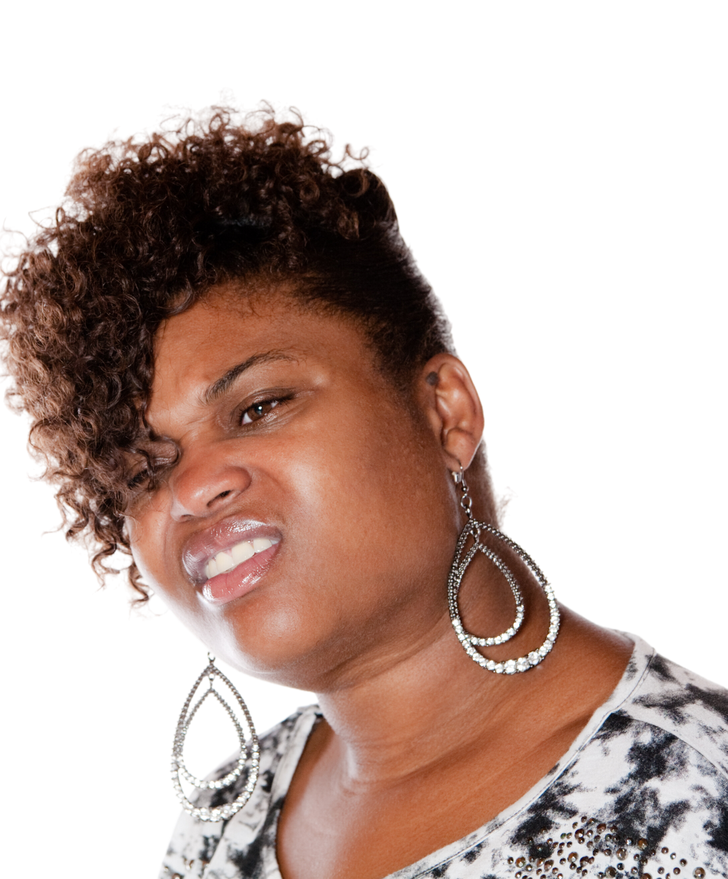
What is Jesus saying?

Slide 12
James 1:13-15
desire has conceived
birth to sin
brings forth death

Slide 13
Why does it matter?

Slide 14
What am I to do?
Notes:
Put on the whole armor of God – Ephesians 6
Be transformed by the renewing of your mind – Romans 12
Set your mind of things above – Col 3:2
Take every thought captive - 2 Cor 10:5
Whatsoever things are . . . .meditate on these things - Phil 4:8-9

Slide 15
What do you want to
be different?
What difference is
it going to make?
What will you do
differently?

